Slide 1
BRAIN TUMOR CLASSIFICATION FROM MRI
Team – 5
Alkesh Shukla – S20210020252
Gaurav Anand – S20210020273
Rohit N – S20210020297

Slide 2
AGENDA
Introduction​
Data Preprocessing
​Feature Extraction - Wavelet
Logistic Regression
Support Vector Machine
Artificial Neural Network
Convolution Neural Network
MobileNetV2 (Pertained Network)

Slide 3
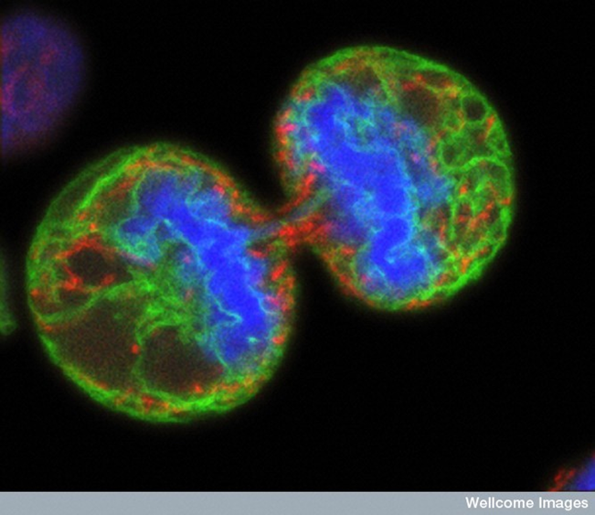
BRAIN TUMOR
A collection of abnormal cells that grows in the brain or central spine canal.
One abnormal cell becomes two, two becomes four, four becomes eight, until there is a lump of abnormal cells.

Slide 4
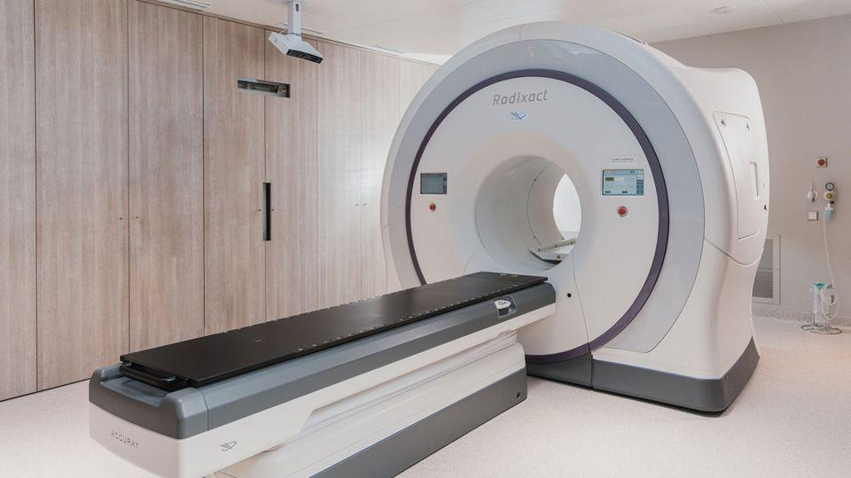
DIAGNOSING BRAIN TUMOR - MRI
Magnetic Resonance Imaging (MRI):
Utilizes powerful magnets and radio waves.
Generates detailed cross-sectional images of the
body's internal structures.
Non-invasive and does not involve ionizing radiation.
Key Features:
Safe diagnostic tool.
Provides comprehensive views of soft tissues,
organs, and the brain.
Utilizes principles of nuclear magnetic resonance.
Advantages:
Enables accurate diagnosis.
Facilitates precise treatment planning.
Offers detailed insights without the use of harmful
radiation.

Slide 5
CATEGORIES
5
Classes of Brain Tumors | Basic Description
Glioma | Originates in glial cells. - Diverse appearances on MRI aid precise identification.
Meningioma | Arises from the meninges. - Distinct features on scans for clear diagnosis.
No Tumor | Absence of detectable tumor. - Provides reassurance, eliminating tumor-related concerns.
Pituitary Tumor | Develops in the pituitary gland. - Recognizable patterns aiding endocrine-related evaluations.

Slide 6
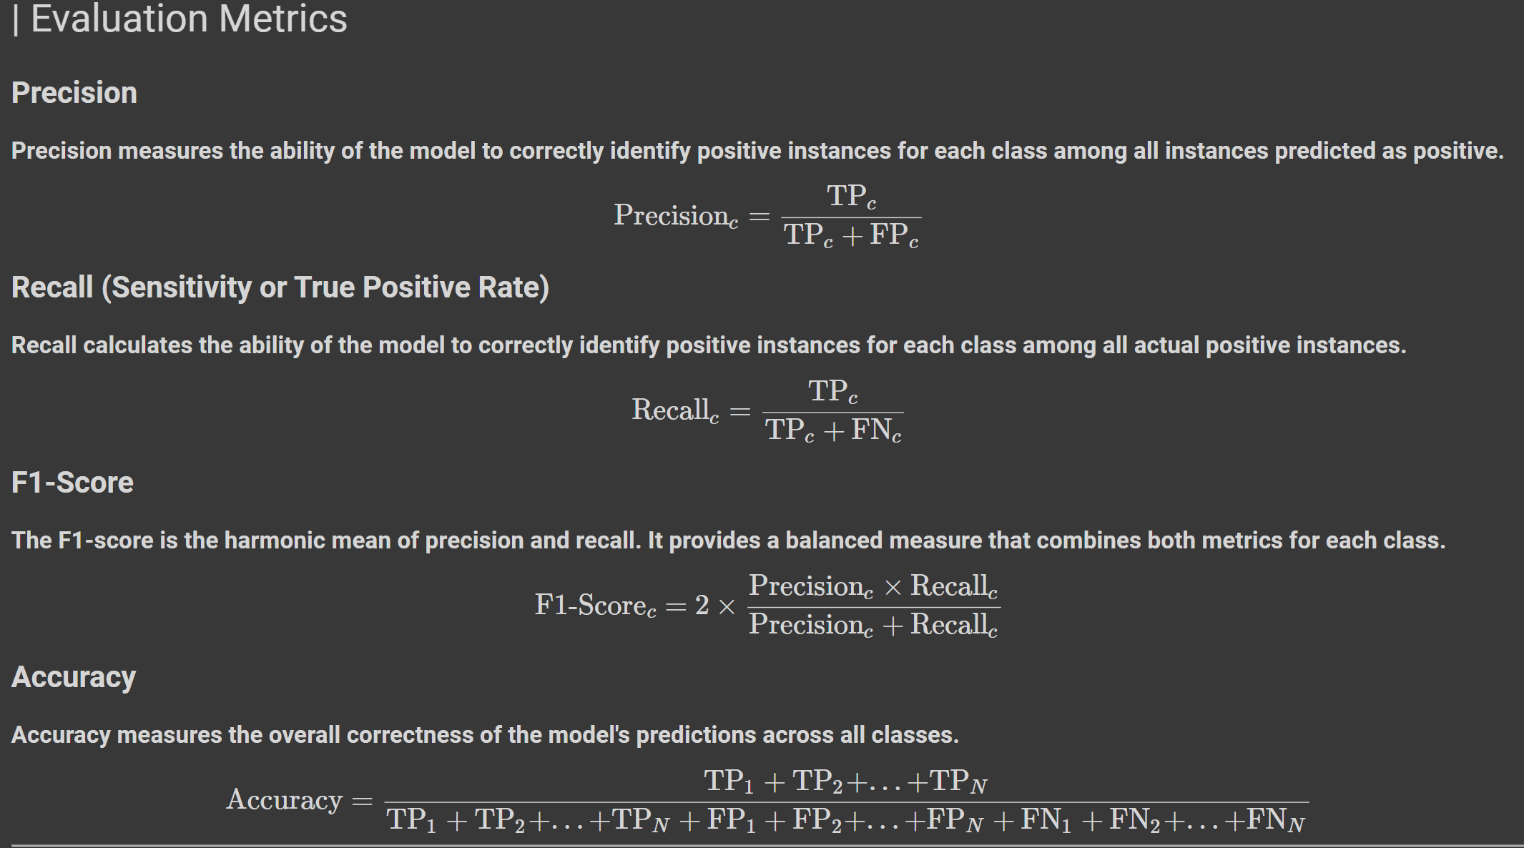
METRICS

Slide 7
DATA PREPROCESSING
Exploring & Augmenting the dataset.

Slide 8
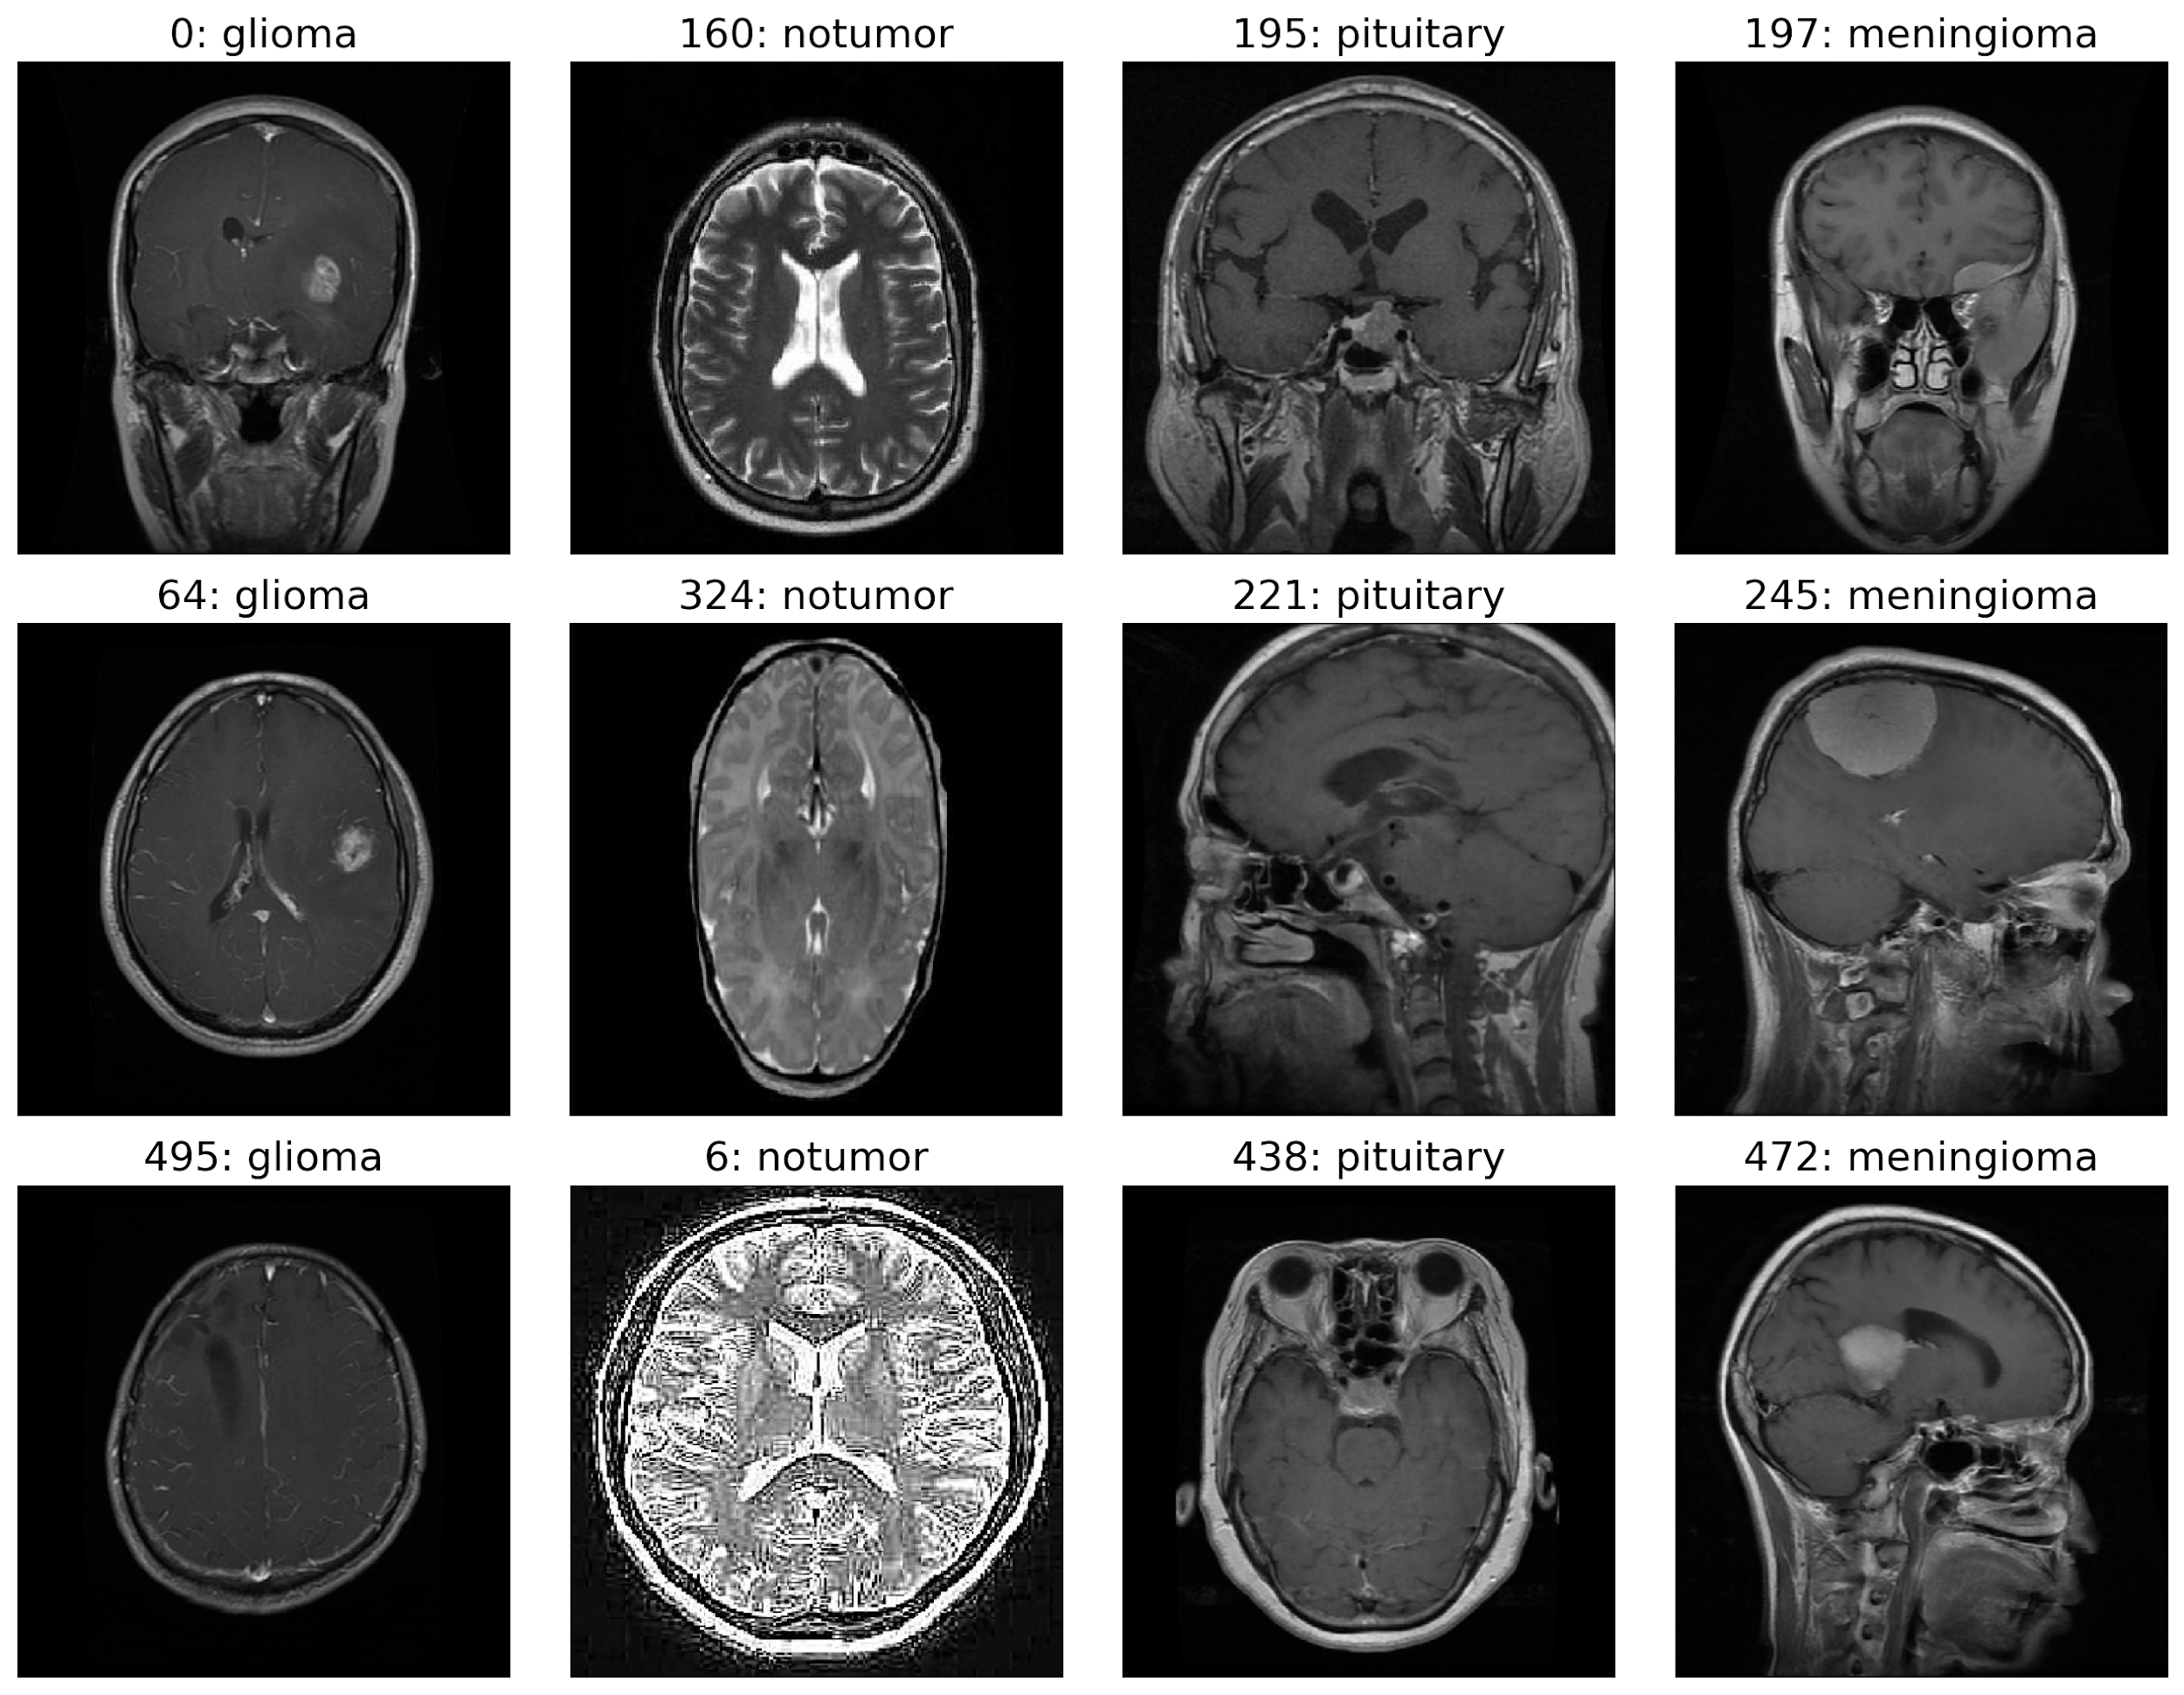
MRI IMAGE DATASET

Slide 9
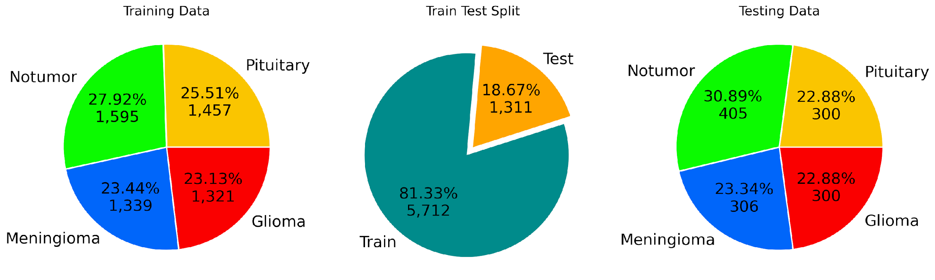
DATA DISTRIBUTION

Slide 10
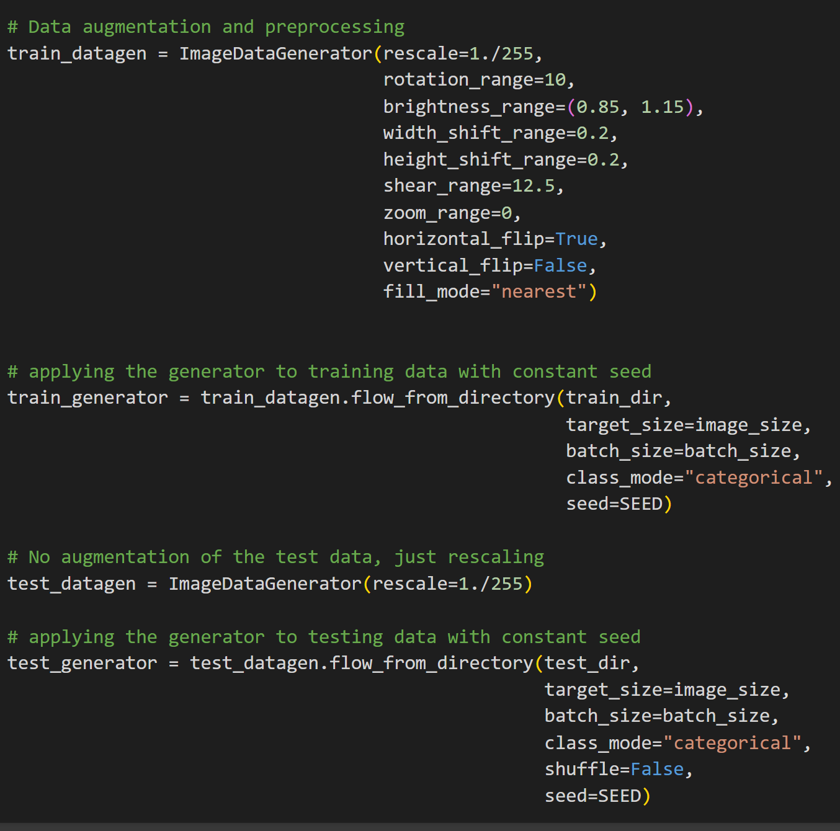
DATA AUGMENTATION
Applying Data Augmentation techniques on the dataset, by using ImageDataGenerator.
Applied the following techniques:
Rescale
Rotate Range : 10 degree
Shifting Width : 0.2 * img_width
Shifting Height : 0.2 * img_height
Sheer : 12.5 * img_height
Horizontal flip
Used flow_from_directory to load data from dataset directories.

Slide 11
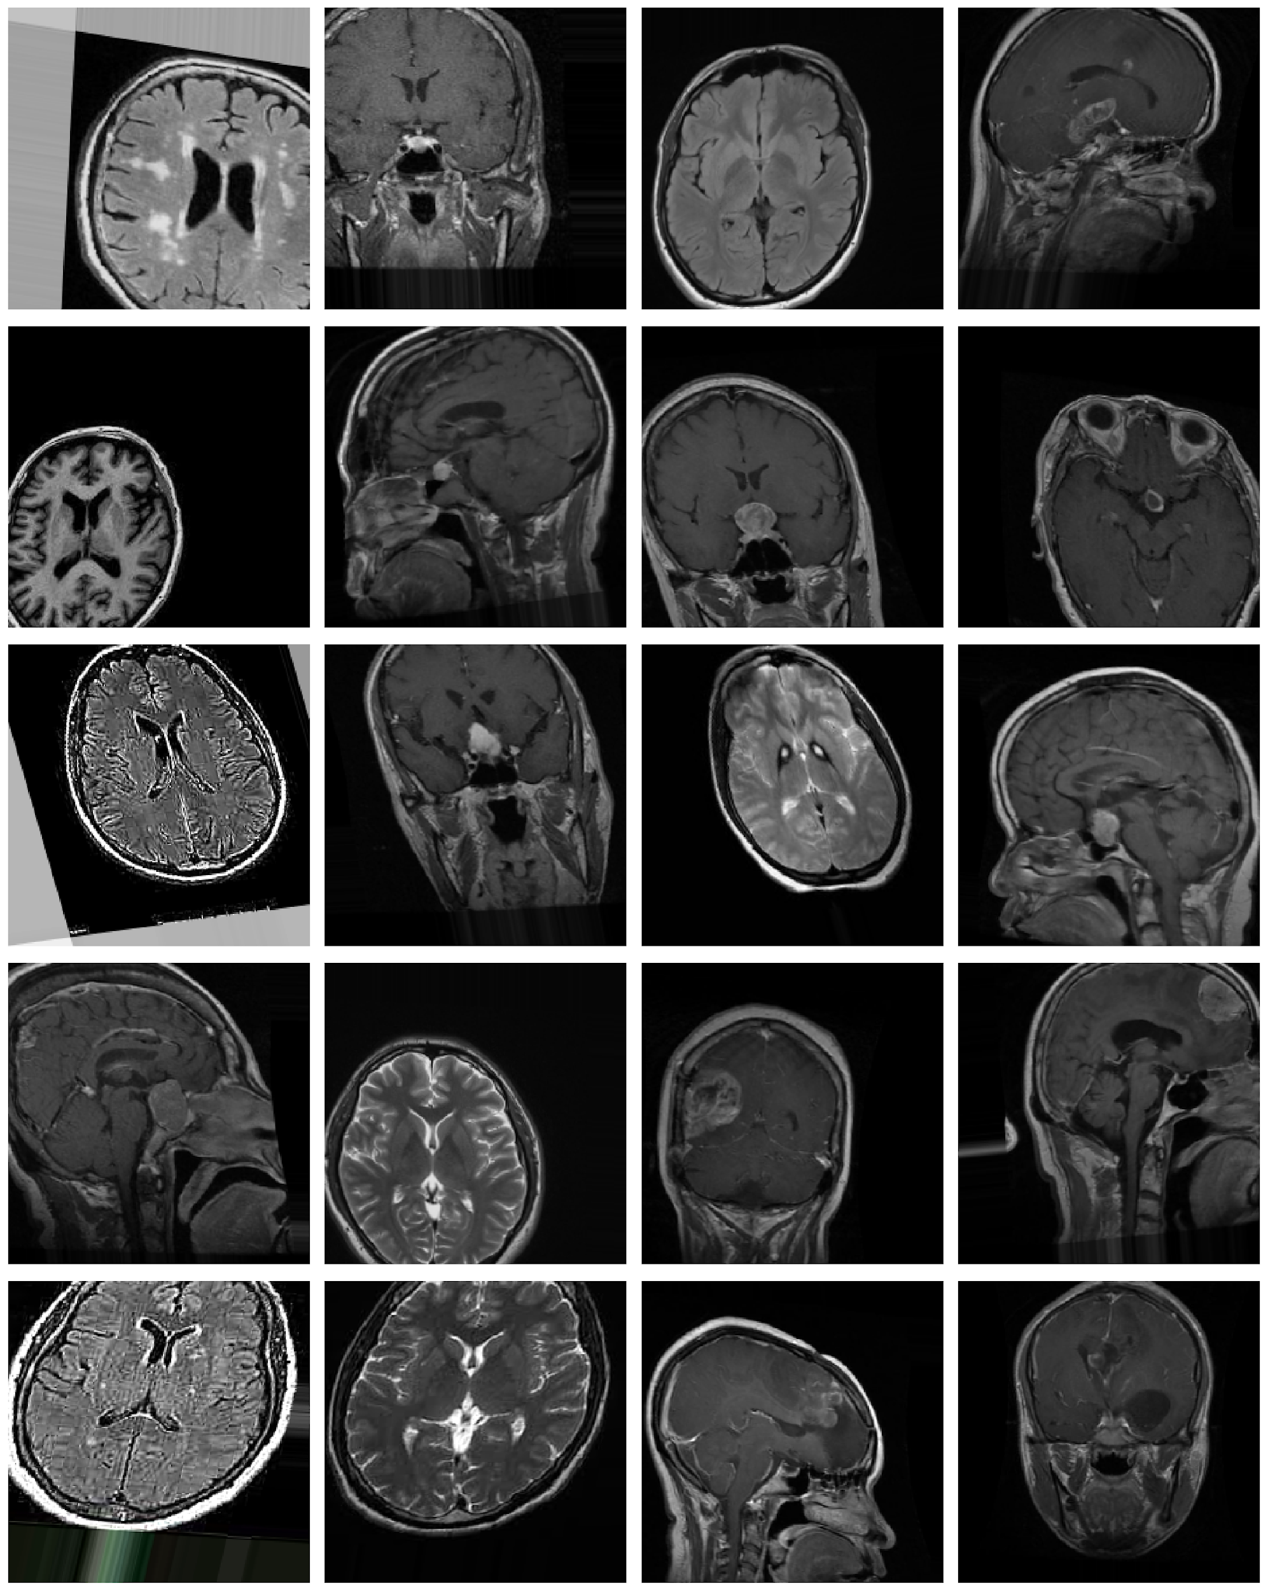
AUGMENTED DATASET
Augmented Dataset involves expanding data collections by adding more examples, enhancing the accuracy and adaptability of artificial intelligence systems. It's like broadening a library for better real-world performance.

Slide 12
FEATURE EXTRACTION
Wavelet Feature Extraction

Slide 13
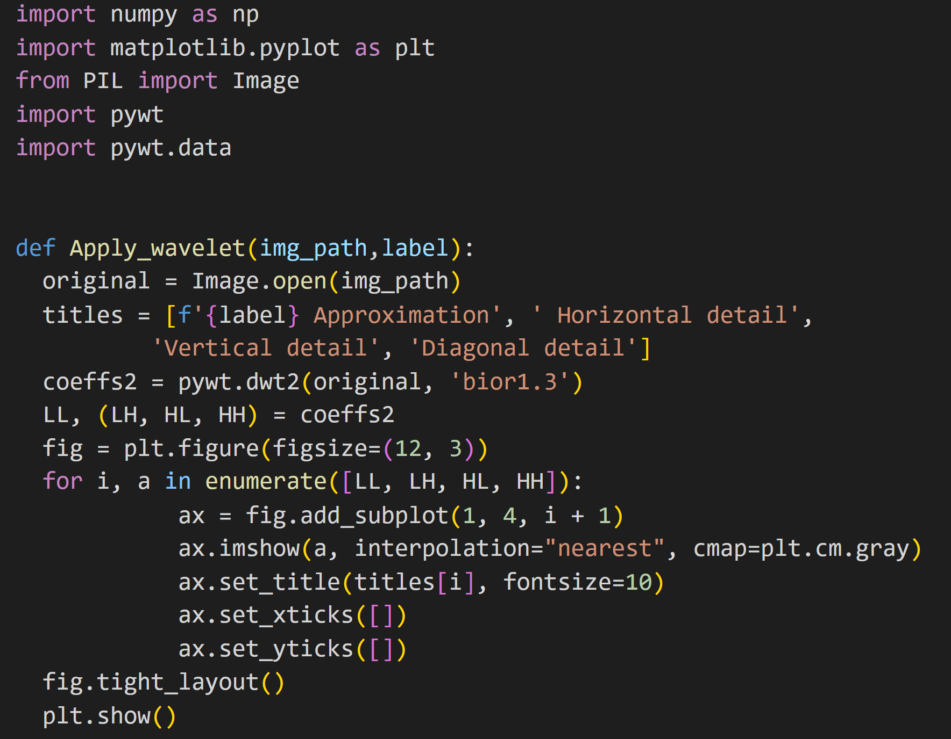
WAVELET FEATURE EXTRACTION
Applied a 2D Discrete Wavelet Transform to an image.
The LL component represents the approximation of the image at a lower resolution.
The LH component contains the high-frequency details in the horizontal direction.
The HL component contains the high-frequency details in the vertical direction.
The HH component contains high-frequency details in both the horizontal and vertical directions.

Slide 14
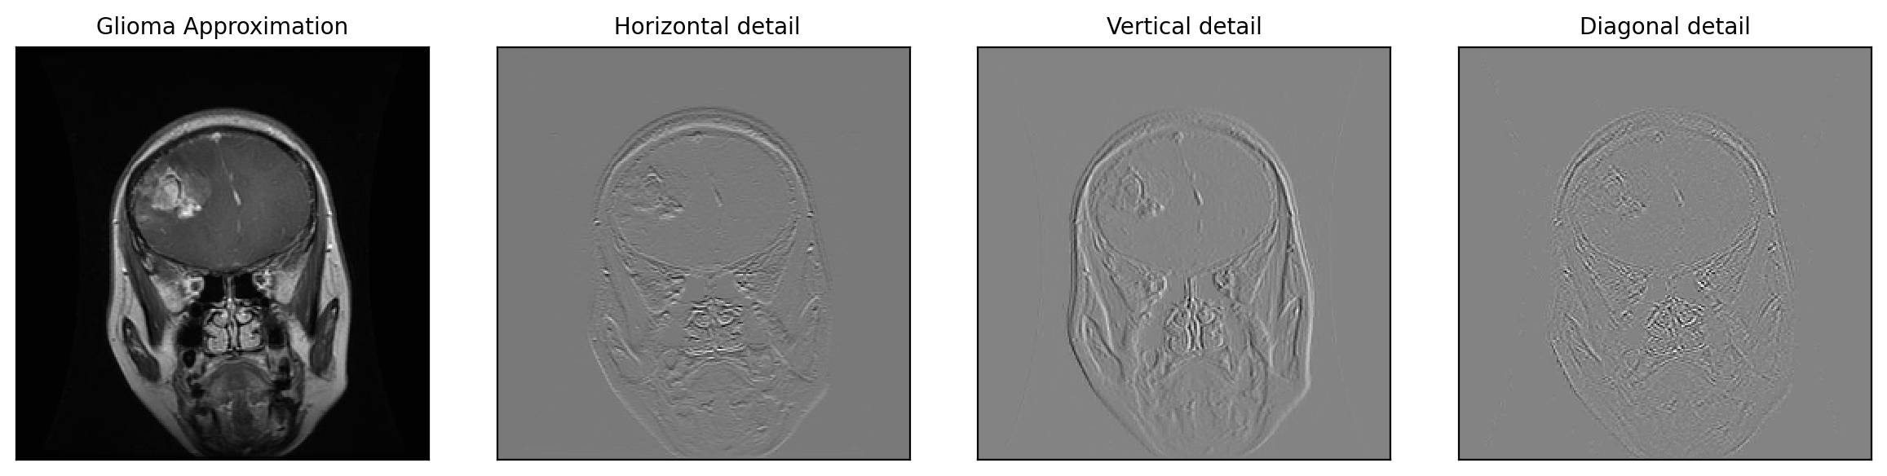
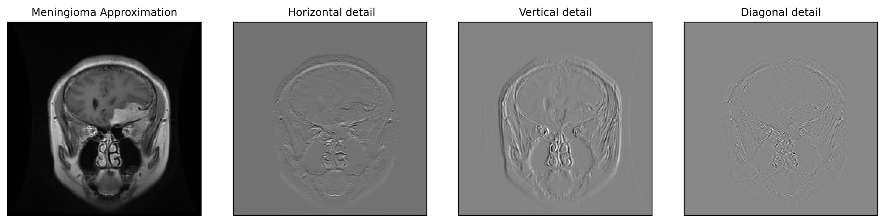

Slide 15
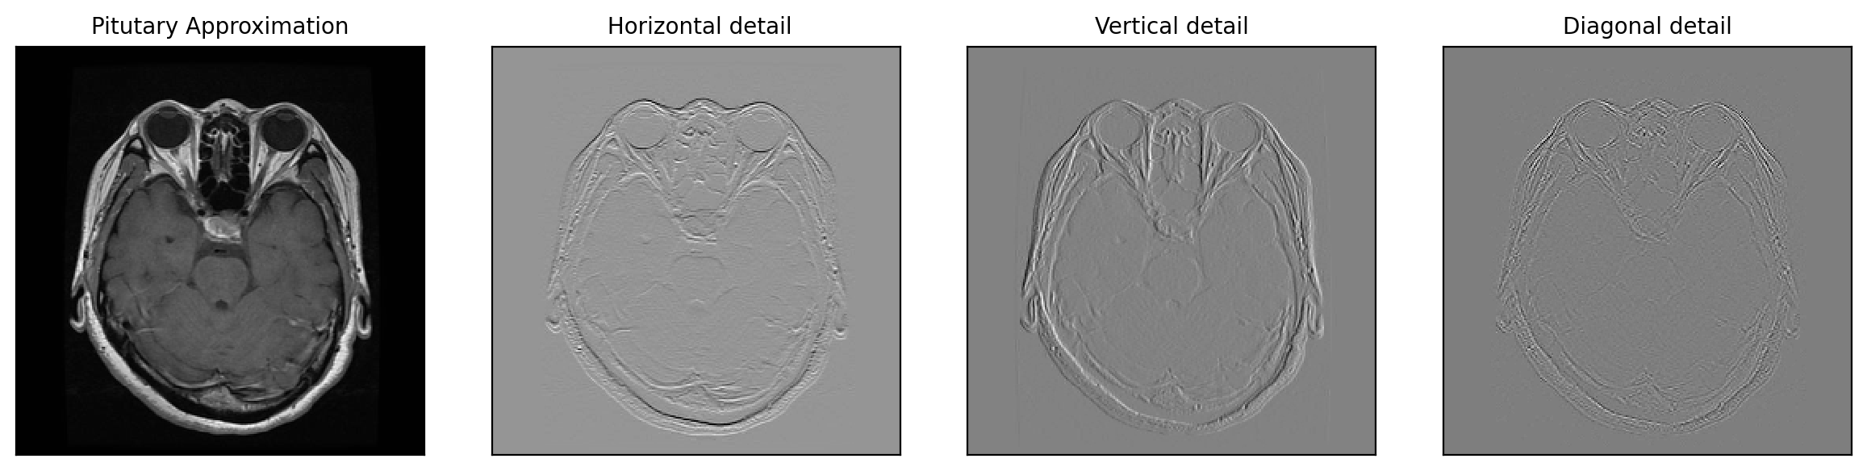
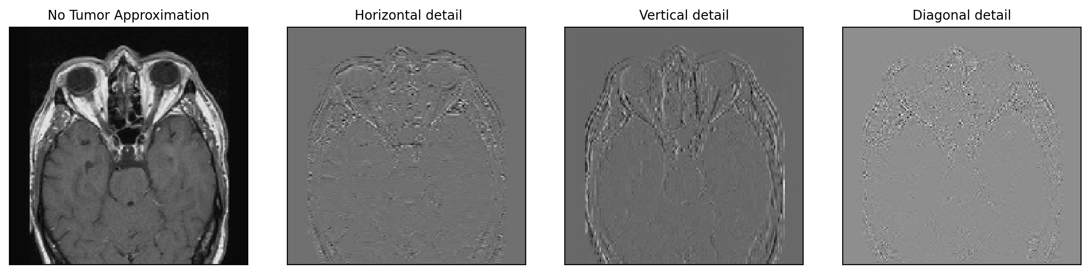

Slide 16
LOGISTIC REGRESSION
Using Logistic Regression from sklearn for multiclass image classification.

Slide 17
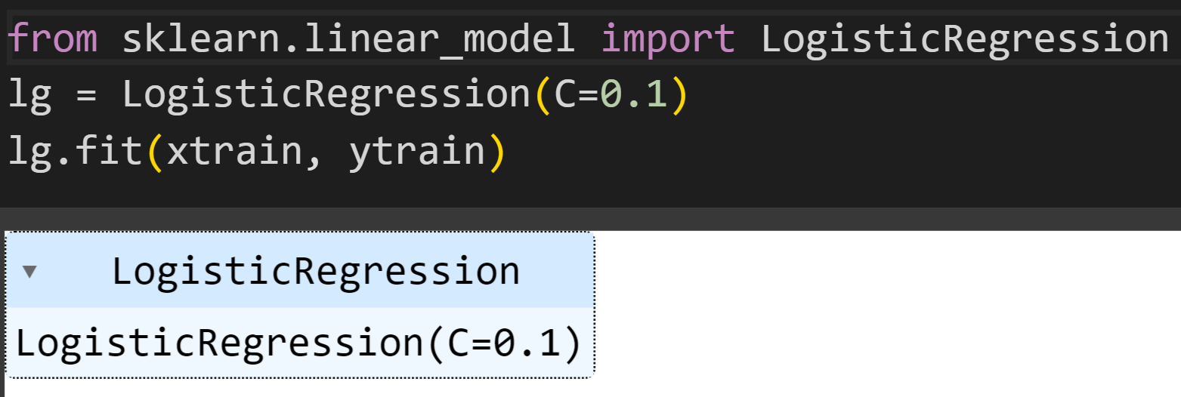
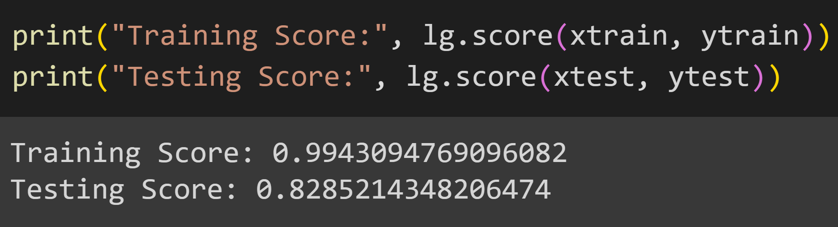
SKLEARN LOGISTIC REGRESSION

Slide 18
SVM
Using Support Vector Machines from sklearn for multiclass image classification.

Slide 19
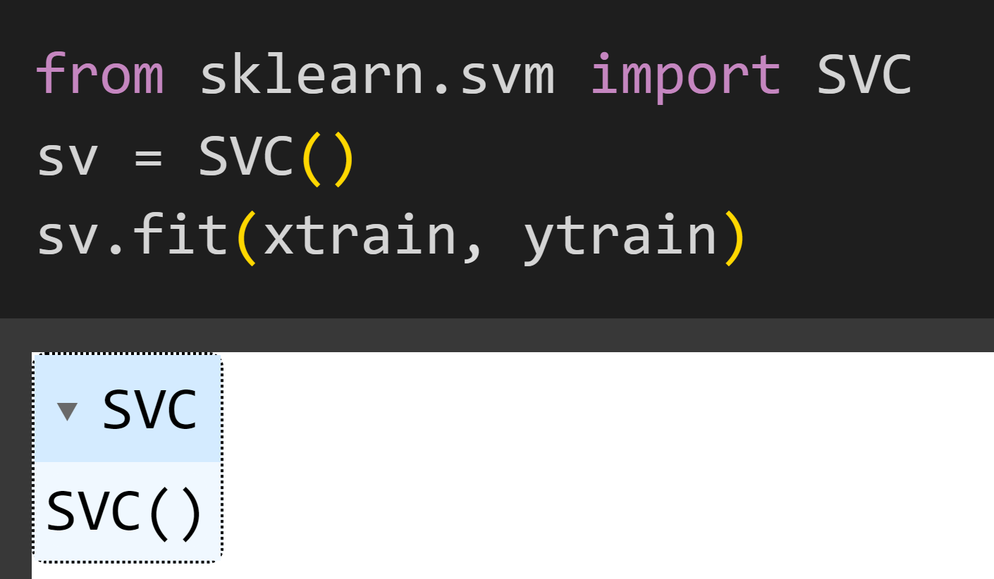
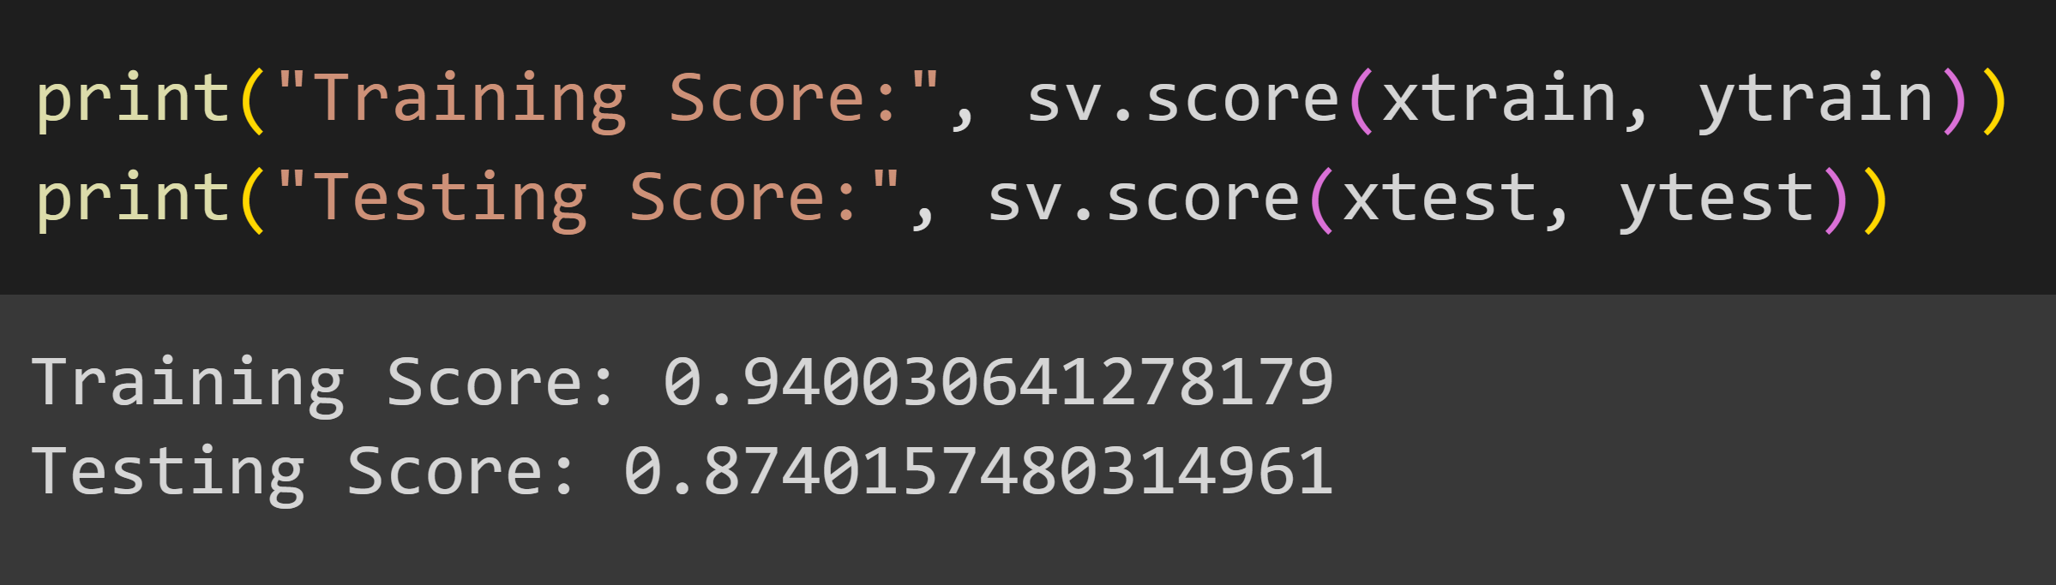
SKLEARN SVM

Slide 20
ARTIFICIAL NEURAL NETWORK
Build & trained ANN for multiclass image classification.

Slide 21
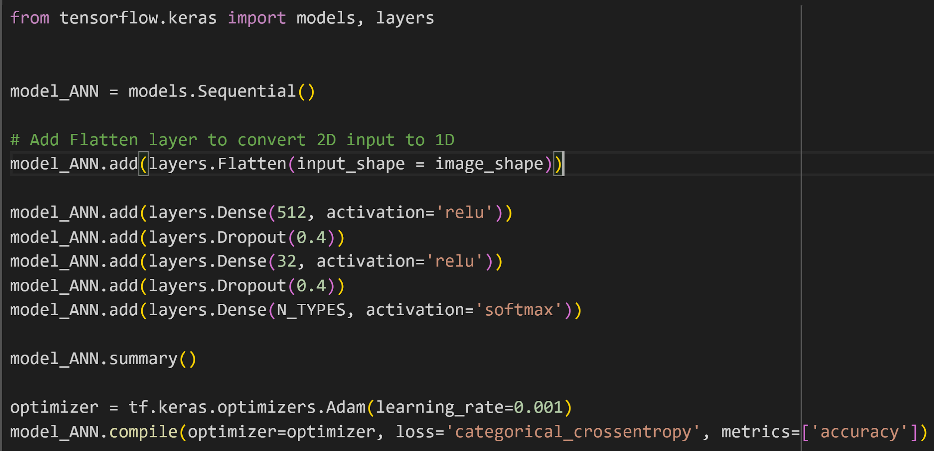
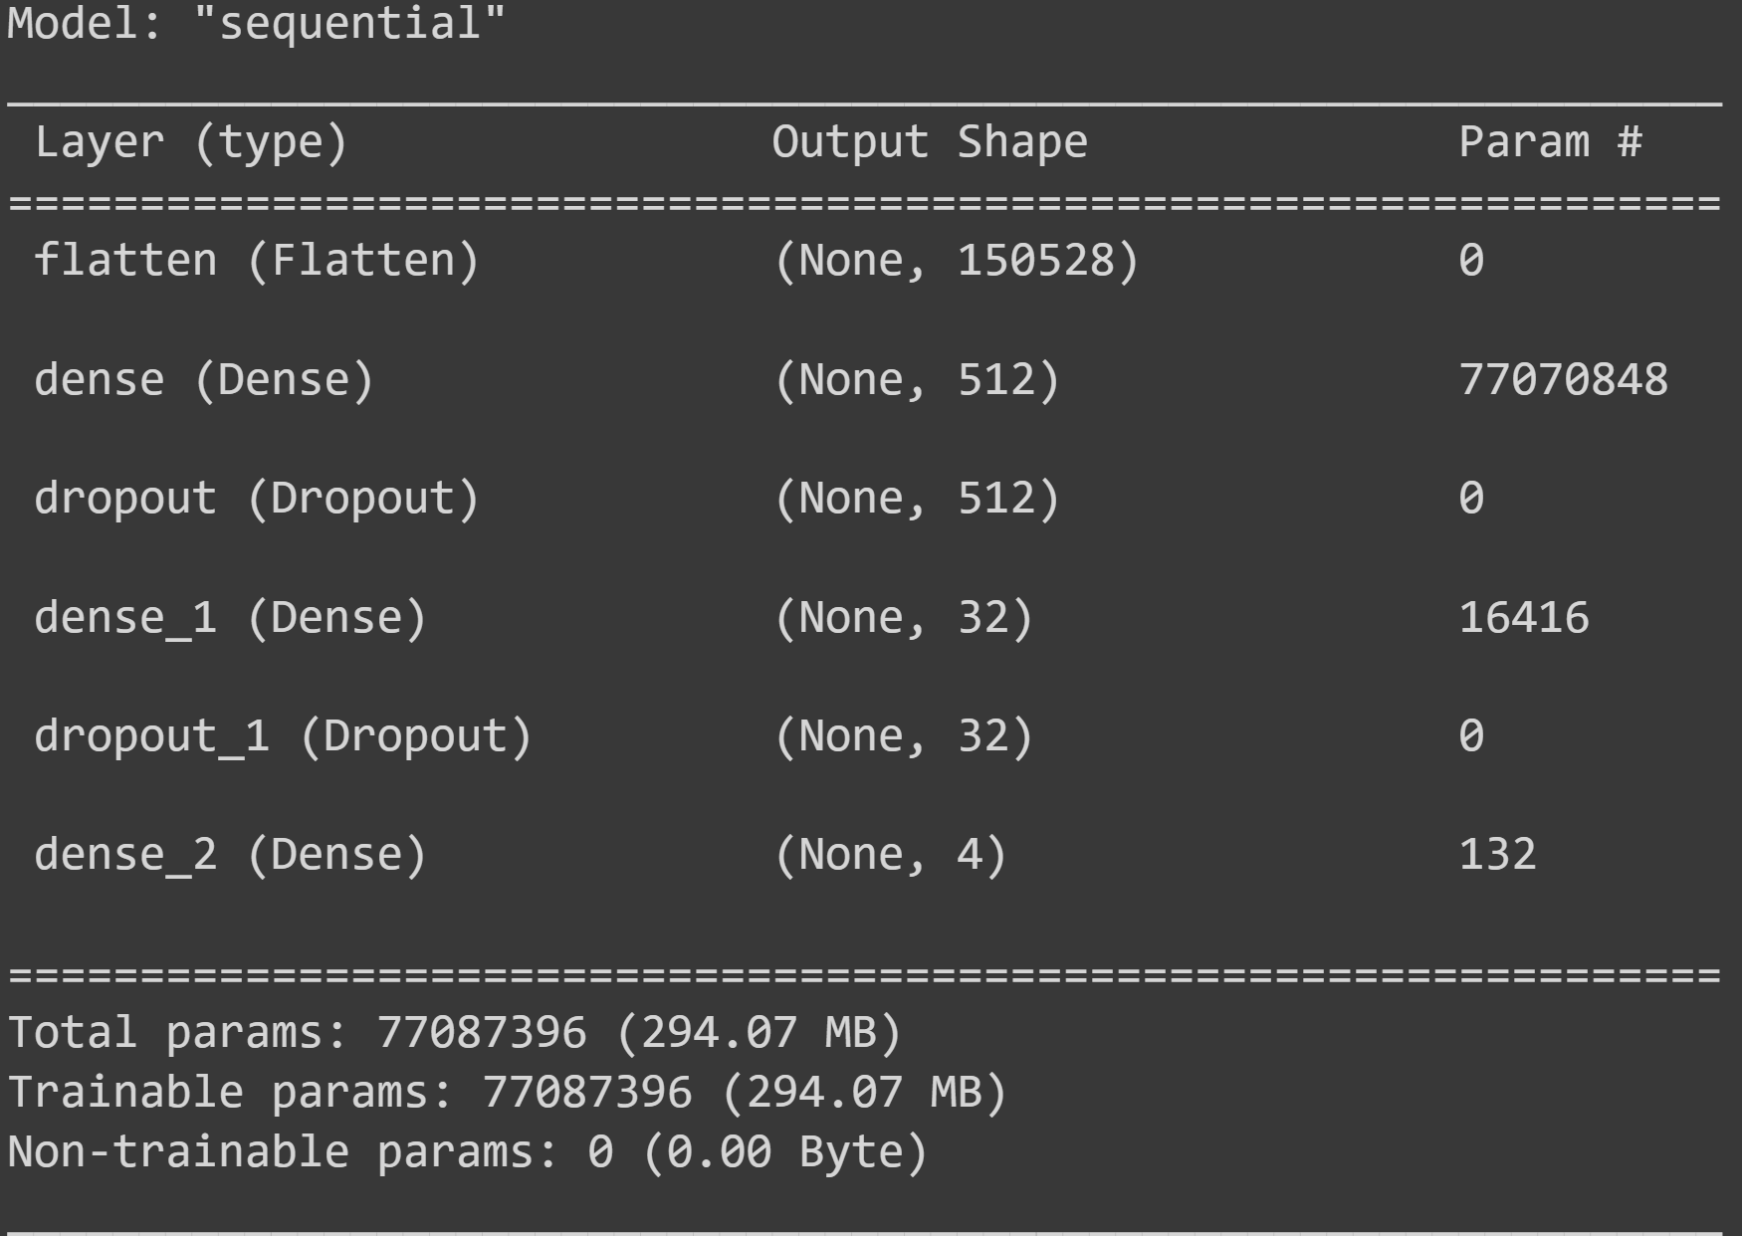
ANN MODEL USING TENSORFLOW

Slide 22
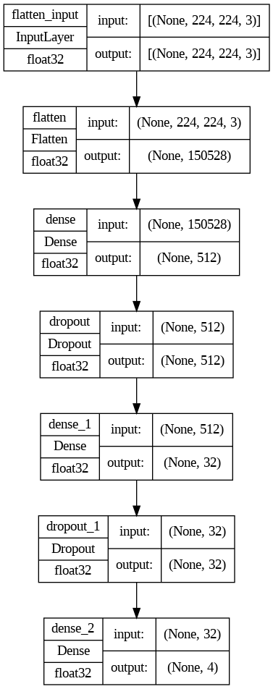
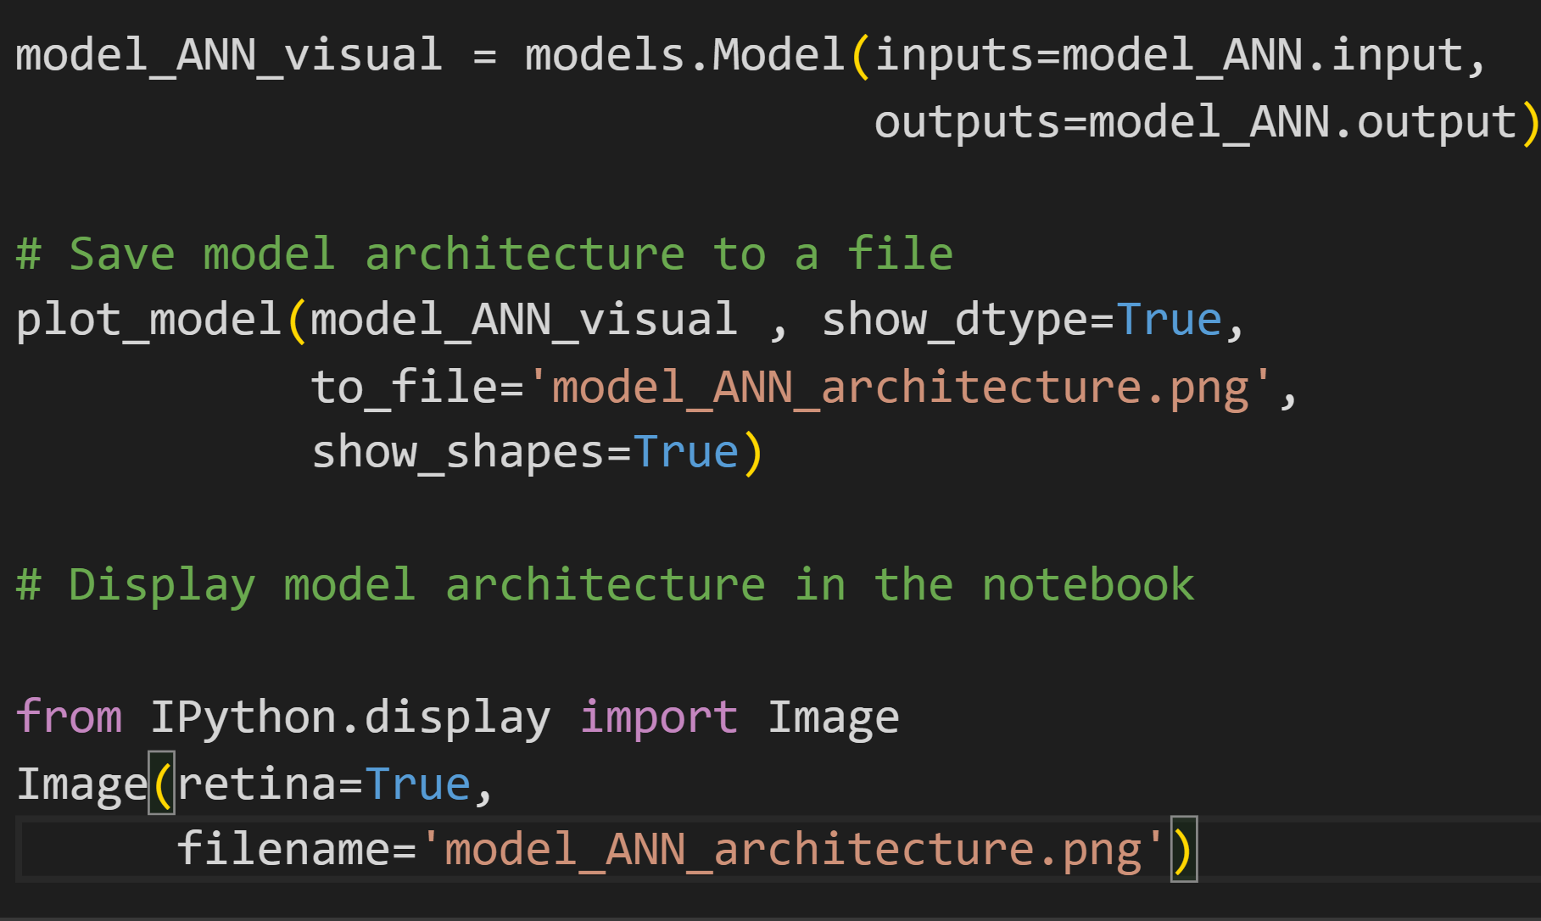
VISUALIZING ANN

Slide 23
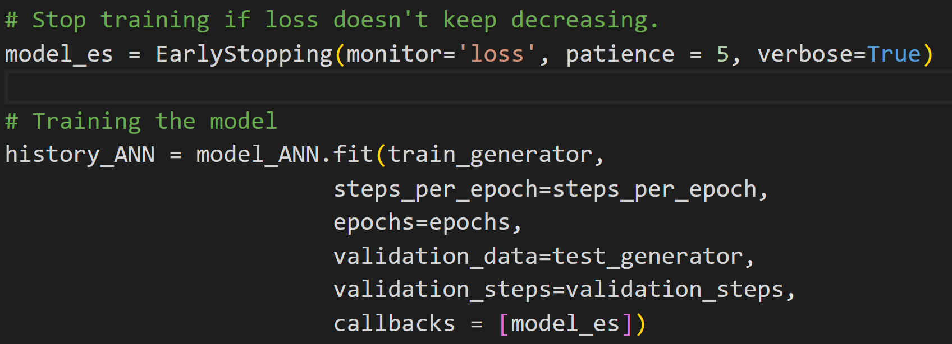
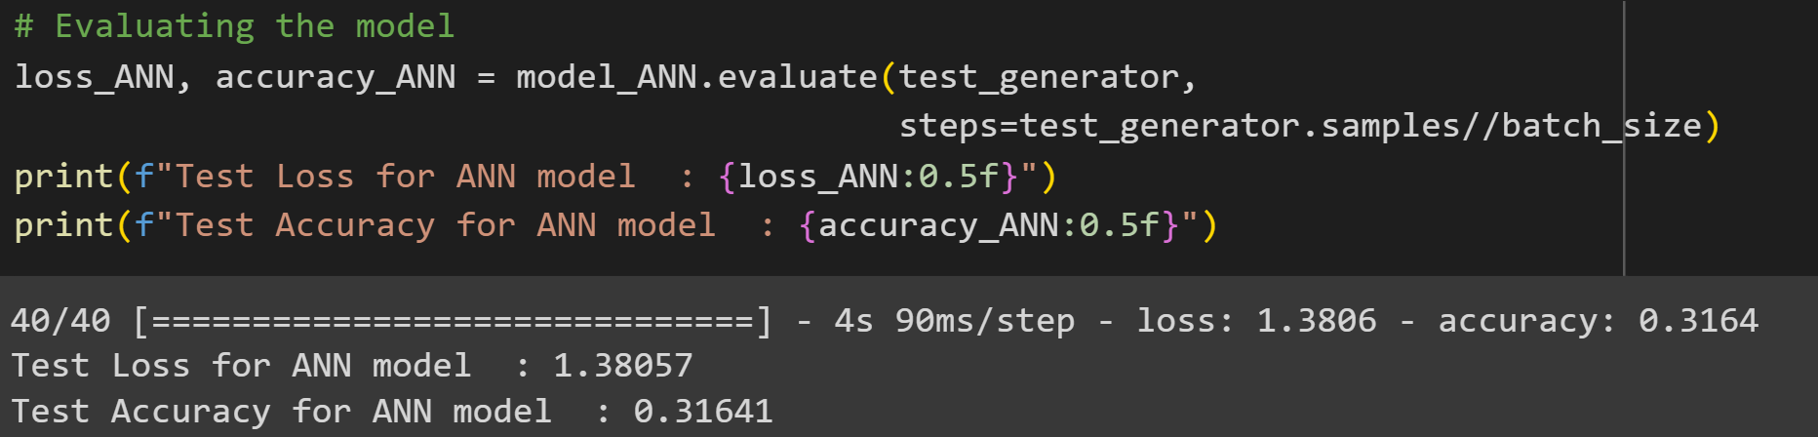
TRAINING & TESTING ANN

Slide 24
CONVOLUTIONAL NEURAL NETWORK
Build & trained CNN for multiclass image classification.

Slide 25
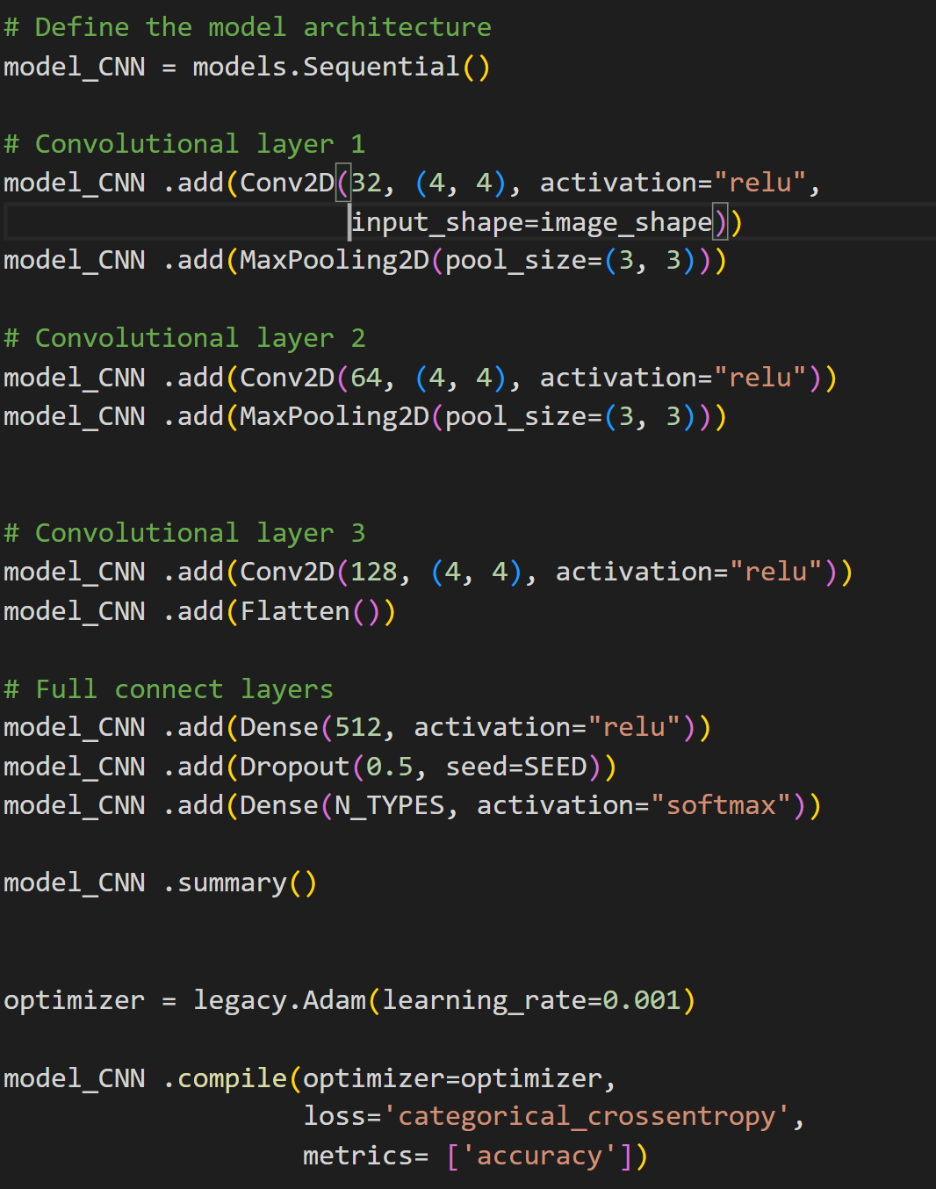
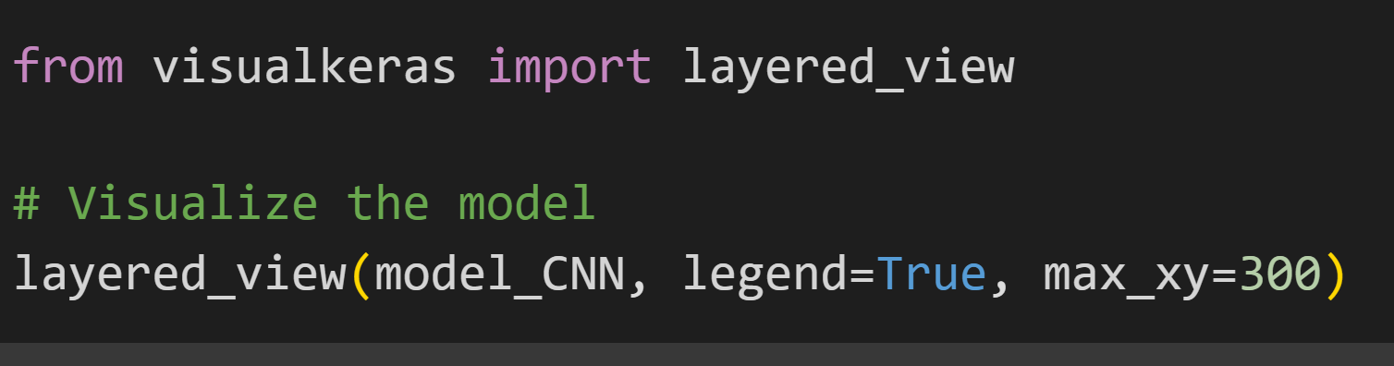
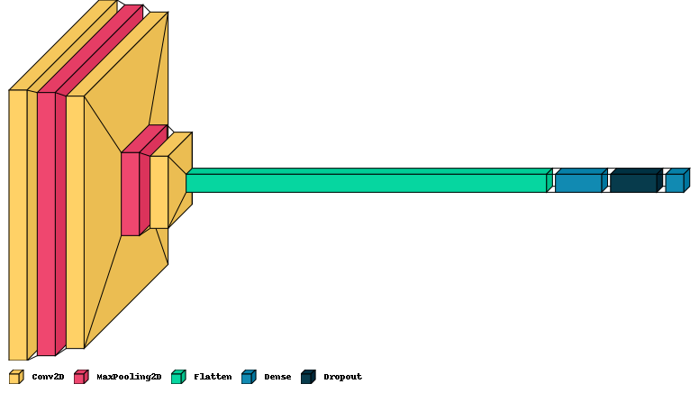
CNN USING TENSORFLOW

Slide 26
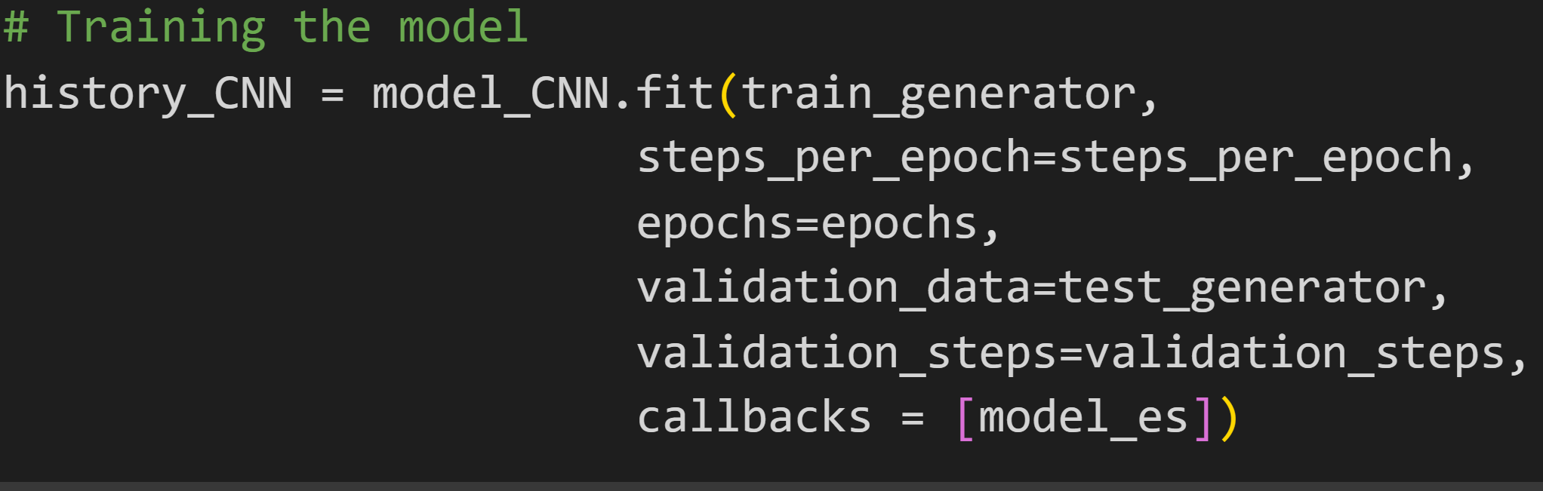
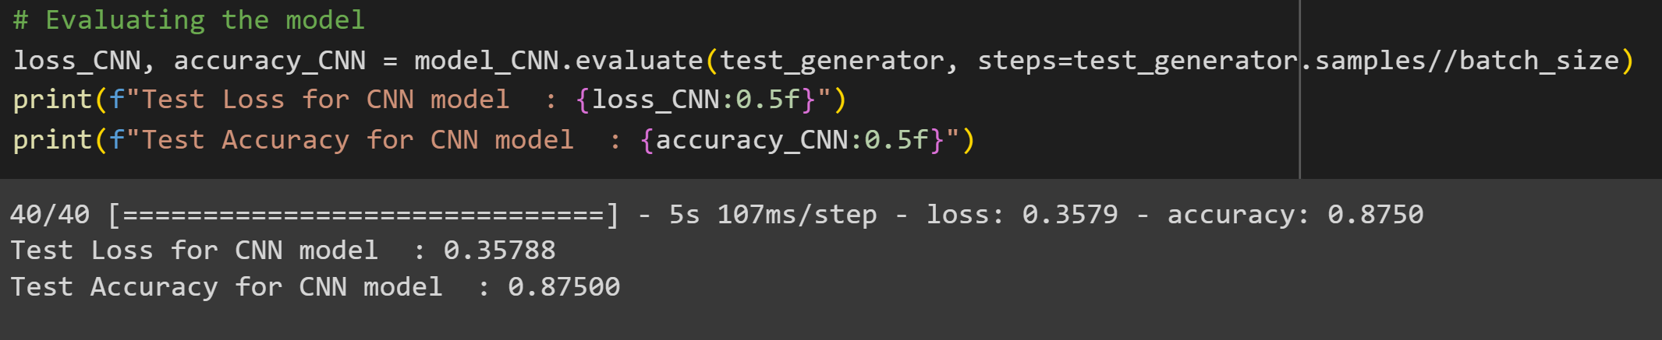
TRAINING & TESTING CNN

Slide 27
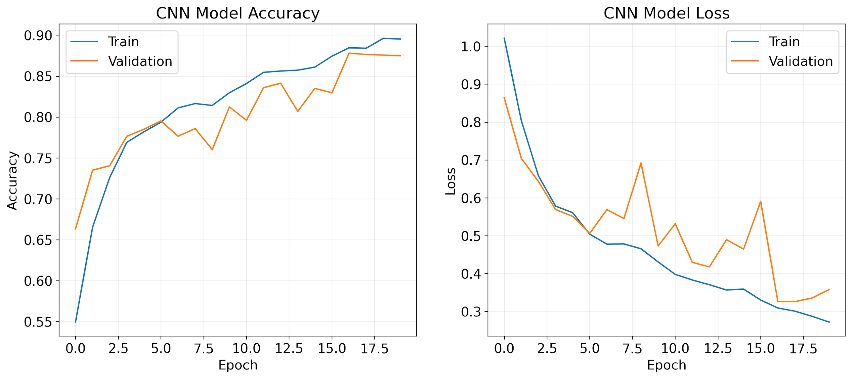
LOSS & ACCURACY PLOTS

Slide 28
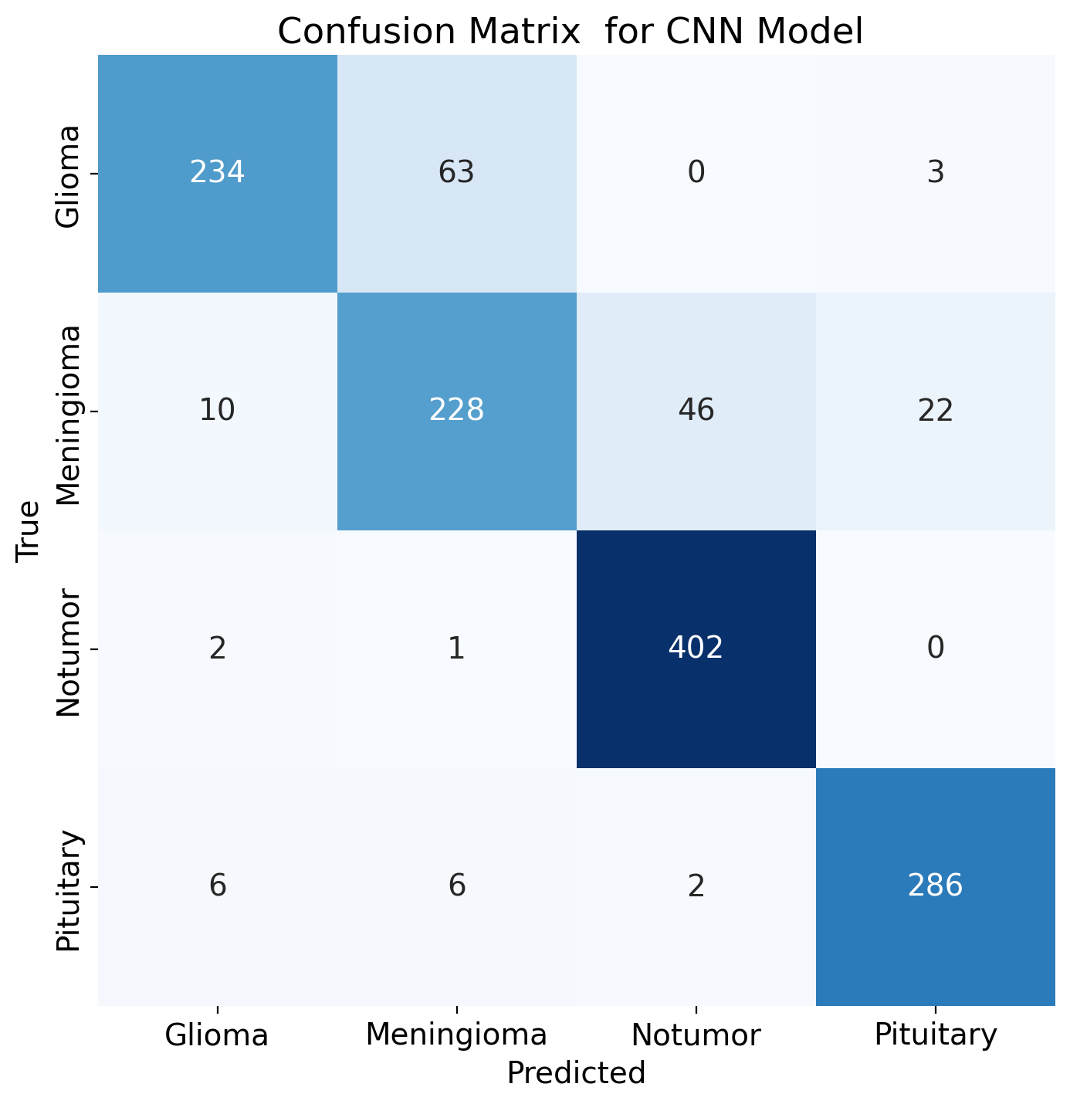
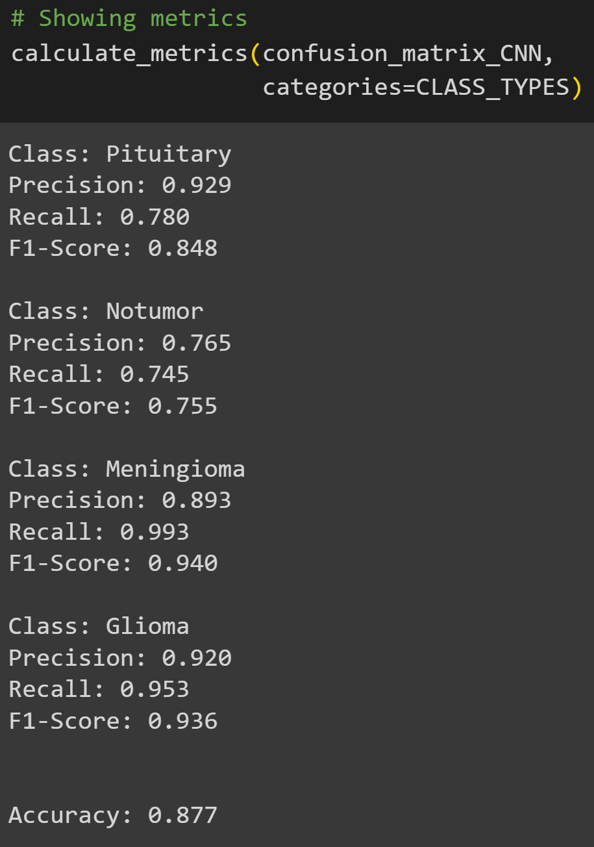
CONFUSION MATRIX & METRICS

Slide 29
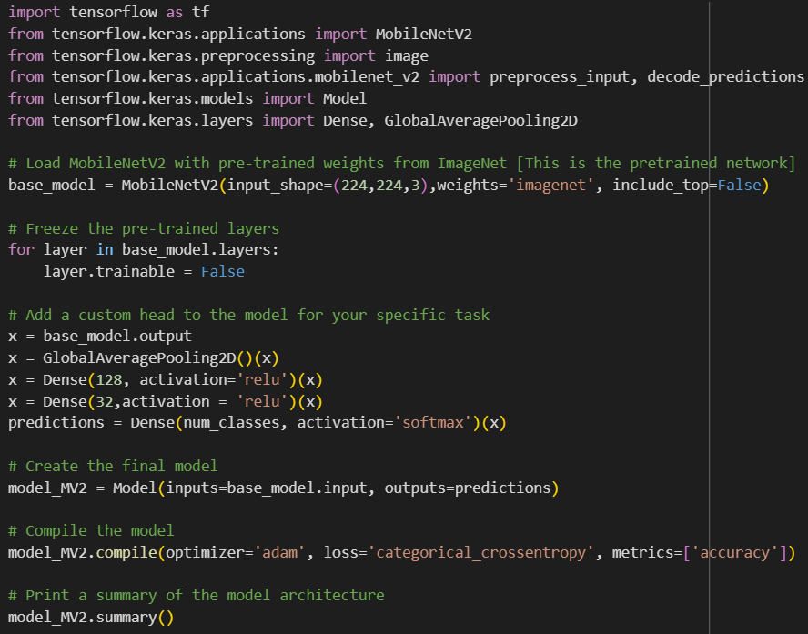
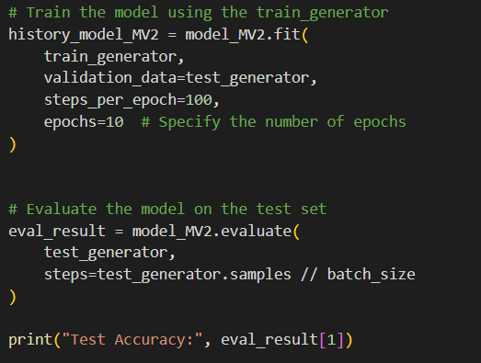
MobileNetV2 USING TENSORFLOW

Slide 30
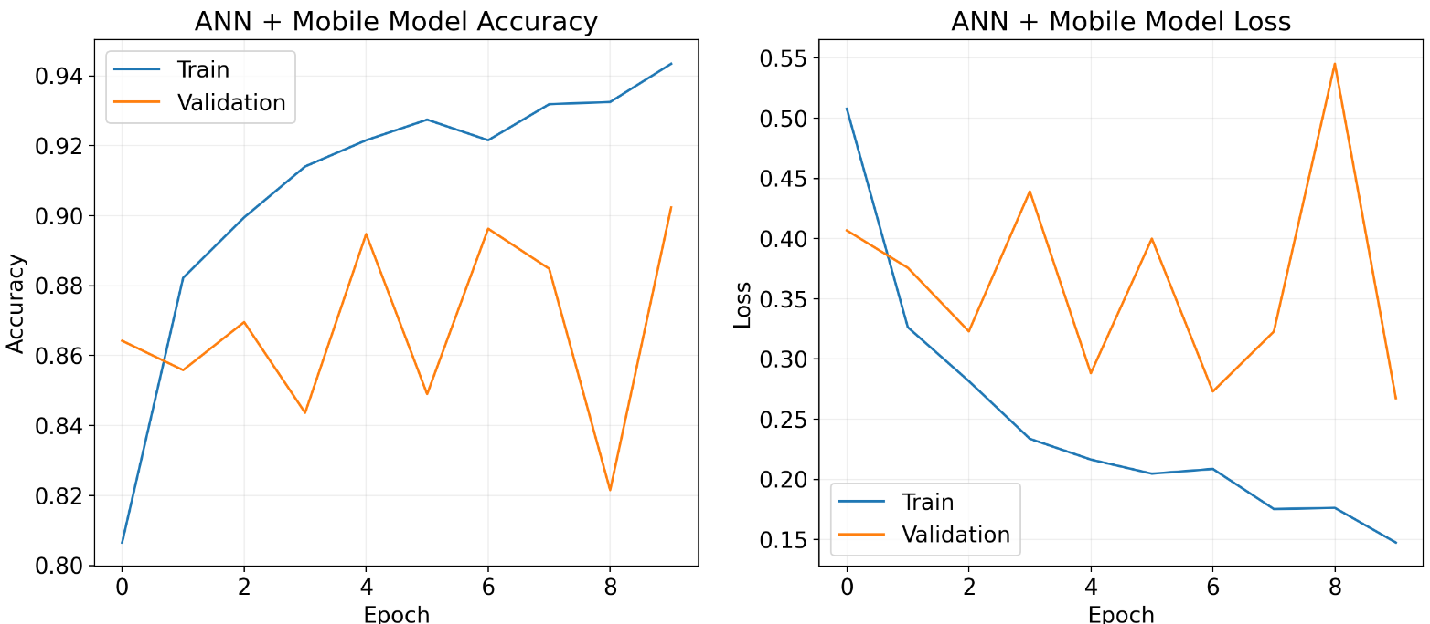
LOSS & ACCURACY PLOTS

Slide 31
Model Evaluation
31
Model used to classify Brain Tumors | Accuracy
Logistic Regression | Training Score: 0.9943094769096082 Testing Score: 0.8285214348206474
Support Vector Machine | Training Score: 0.940030641278179 Testing Score: 0.8740157480314961
Artificial Neural Network | Test Loss for ANN model : 1.38057 Test Accuracy for ANN model : 0.31641
Convolution Neural Network | Test Loss for CNN model : 0.35788 Test Accuracy for CNN model : 0.87500
MobileNet + ANN | Test Loss : 0.1694 Test Accuracy : 0.9023

Slide 32
THANK YOU
Team – 5
Alkesh Shukla – S20210020252
Gaurav Anand – S20210020273
Rohit N – S20210020297
Github Repository link:
https://github.com/shuklaAlkesh/Brain-Tumor-Detector-using-MRI-Images-.git

